Slide 1
Finding an Optimal Location for a Fitness Center in Dallas
Fangwei Han
2020.06.02

Slide 2

Introduction
Dallas is one of the major cities in Texas and stakeholders are often interested in all kinds of businesses in the City area. I found there were not enough gyms or fitness centers in the area.
This would be a great city for stakeholders who want to open a fitness center. In the project, I will try to help stakeholder find a perfect location to open a fitness center in the city of Dallas.

Slide 3
Data acquisition and cleaning
The data of Dallas neighborhoods is available at: http://peopleorganizingplace.com/know/.
Foursquare will be used to obtain venue information of all the neighborhoods in the city of Dallas.
The address and coordinates data of Dallas can be obtained from geopy package.
The cleaned data frame contains 375 rows and 7 columns.

Slide 4
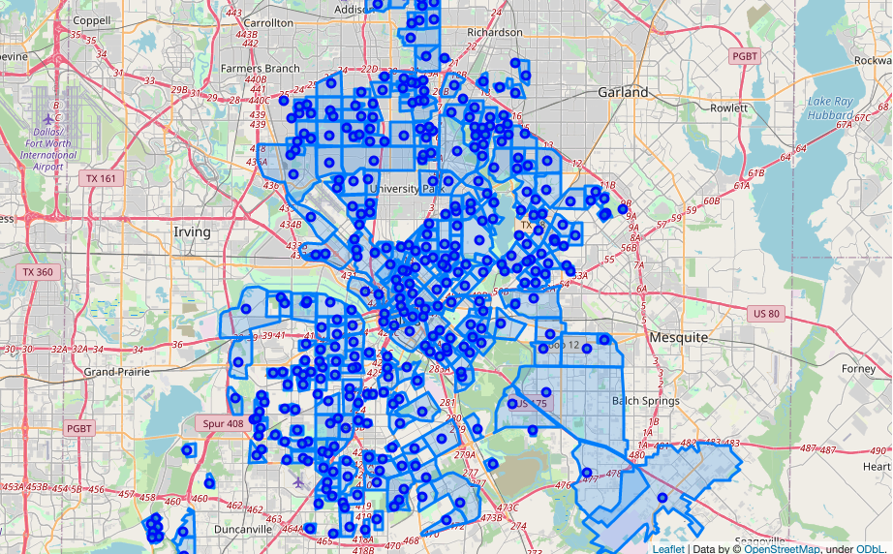
Neighborhood locations on the map of Dallas

Slide 5
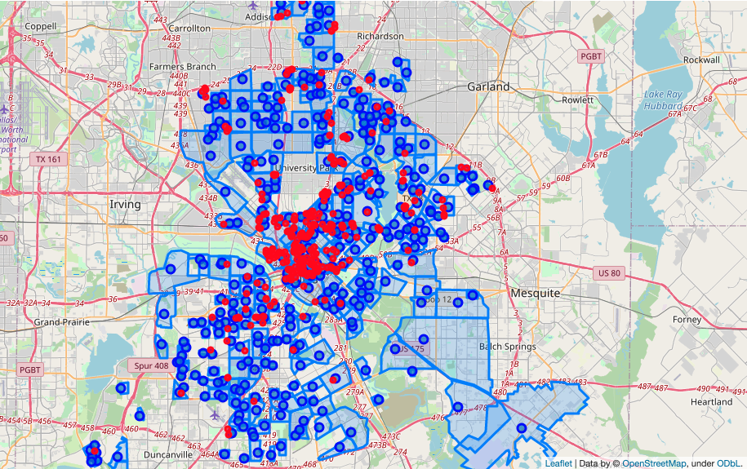
Gym locations on the map of Dallas

Slide 6
Analysis-Heatmap
Nearby gyms <= 1: Good locations.
Nearby gyms > 1: Bad locations.
Heatmap was created for good locations. The “hot” areas represent the high density of “good locations” with few gyms and the “cold” areas represent the “bad locations”.

Slide 7
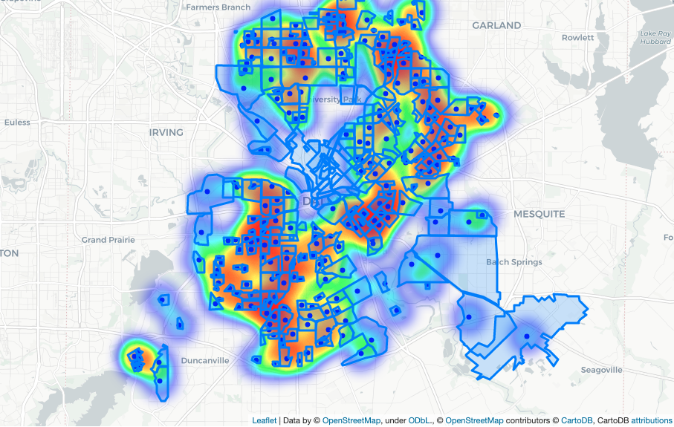
Heatmap of good locations

Slide 8
Analysis-Clustering
Good locations were clustered using k-means clustering.
Number of clusters: 15.
The center of the clusters were plotted on the map of Dallas.
The centers of the clusters should be considered the optimal locations for a new gym.

Slide 9
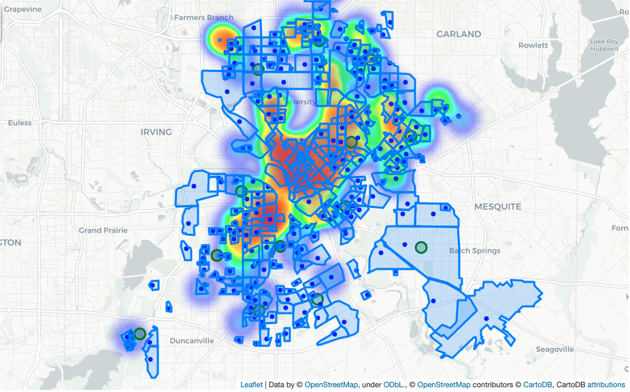
Clusters of good locations

Slide 10
Results
The addresses of the cluster centers:
2424, 56th Street, Fruitdale, Dallas, Dallas County, Texas, 75241, United States of America
11606, Saint Michael's Drive, Gifford, Dallas, Dallas County, Texas, 75230, United States of America
6396, Eagle Ford Drive, Ledbetter Hills, Dallas, Dallas County, Texas, 75249, United States of America
9778, Twin Creek Drive, Reinhardt, Dallas, Dallas County, Texas, 75228, United States of America
2111, Singleton Boulevard, Eagle Ford, Dallas, Dallas County, Texas, 75212, United States of America
1331, Cedar Oaks Boulevard, Bishop Arts District, Oak Cliff, Dallas, Dallas County, Texas, 75216, United States of America
8342, Nisqually Street, Dallas, Dallas County, Texas, 75217, United States of America
4520, Frankford Road, Dallas, Collin County, Texas, 75287, United States of America
3822, Poinsettia Drive, Oak Cliff, Kenwood, Dallas, Dallas County, Texas, 75211, United States of America
3311, Rutledge Street, Fair Park, Sargent, Dallas, Dallas County, Texas, 75215, United States of America
10125, Fieldfare Court, Meaders, Dallas, Dallas County, Texas, 75229, United States of America
White Rock Trail, Lake Highlands, Dallas, Dallas County, Texas, 75238, United States of America
5717, South Polk Street, Westwood Park, Dallas, Dallas County, Texas, 75232, United States of America
6910, Echo Bluff Drive, Renner, Dallas, Dallas County, Texas, 75248, United States of America
6651, Lakeshore Drive, Lakewood, Rawlins, Dallas, Dallas County, Texas, 75214, United States of America

Slide 11
Discussion
The geometry coordinates arrays were converted to a single pair of coordinates by calculating the mean of latitudes and longitudes. However, since each neighborhood has its unique shape and area, it is possible that the mean of the coordinates cannot represent the corresponding neighborhood very well.
All kinds of gyms were taken into account in the Foursquare data preparation step and this included the fitness center with specific functions such as boxing centers, yoga centers, etc. To help a stakeholder who wants to open a multifunctional fitness center, these types of fitness centers should not be included in the analysis. This should be addressed in future analyses.

